Slide 1
Enhancing the Safety and Authenticity of Online Discussions on Social Media Platforms with AI
Group B1: Metrics
Supervised by:
Mr. Kai Kugler
Team Members:
Aastha Shreya
Farhan Ali Arshad
Shivang Sinha
Syed Huzaifa Ali
Muhammad Ahmed
Donya Sheikhi

Slide 2
Introduction
Social media has made it easier for people to share information and connect with others.
However, it is also used to spread fake news and create online threats like hate speech and cyberbullying.
Fake news tricks people and changes their opinions, while threats create a hostile and unsafe environment.
Current systems address fake news and threats separately, overlooking their interconnected nature.
Transformer-based models (e.g., BERT) excel in text classification but multitask detection of fake news and threats remains underexplored.
Research focuses on evaluating separate versus unified detection models and analyzing transformer trends (encoders, decoders, hybrids).

Slide 3
Problem Statement
Fake news divides communities and reduces trust.
Threats stop useful conversations and increase negativity.
Fake news and threats often overlap, making problems worse.
Limited studies comparing tools that handle both issues together.

Slide 4
Research Questions
How does the performance of separate BERT models trained individually on fake news and threat datasets compare to a single BERT model trained unified on both datasets and which approach yields better results for combined detection tasks?
What are the conclusions be drawn from the combined detection of fake news and threats? How can it contribute to improving societal safety, fostering informed public engagement, and enhancing the quality of social media?
What are the trends in different transformer models ( Encoder, Decoder, Hybrid ) while detecting online threats & fake news detection?

Slide 5
Objectives
Compare separate and combined BERT models to evaluate their performance in detecting fake news and threats.
Train specialized models for fake news and threat detection individually.
Build a multitask BERT model addressing both tasks simultaneously.
Investigate how integrating fake news and threat detection in one framework improves efficiency and accuracy.
Minimize computational overhead for practical implementation.
Study how improved detection mechanisms reduce harmful content.
Promote public awareness and create safer online interactions.
Examine encoder-based, decoder-based, and hybrid transformer models to determine their effectiveness

Slide 6
Methodologies
Data Collection & Preprocessing:
Use datasets for fake news (e.g., DeFaktS) and threats (e.g., hate speech).
Clean text, extract key features.
Model Training:
Train separate BERT models for fake news and threats.
Build a combined BERT model with shared layers.
Evaluate models using accuracy, F1-score, precision, & recall to determine performance.
Architecture Exploration:
Experiment with encoder-based (BERT), decoder-based (GPT), and hybrid models for comparative performance analysis.
Output Generation:
The models will produce binary outputs for each task: o Fake News Detection: Fake (1) or Not Fake (0). o Threat Detection: Threat (1) or No Threat (0).

Slide 7
Methodologies
Evaluation of Combined Detection Impact:
Measure improvements in predictive performance when fake news and threats are detected simultaneously.
Conduct comparative analysis on datasets processed through separate versus unified models to assess accuracy gains and computational efficiency

Slide 8
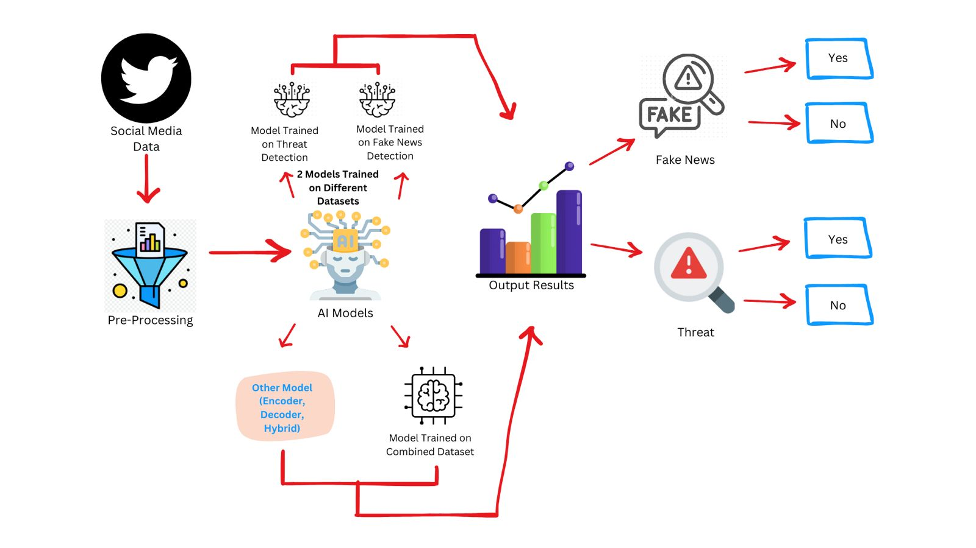
Methodologies

Slide 9
Metrics for Evaluation
Fake News Detection Metrics:
To evaluate fake news detection, the system will analyze textual features derived from disinformation indicators, including but not limited to.
Semantic Inconsistency:
Identifying contradictions or logical errors within the content to flag unreliable posts.
Polarization:
Detecting friend-foe framing narratives in fake news articles.
Vagueness of Phrasing:
Analyzing the use of indirect expressions or hedging words.
Authenticity and Referencing of Information:
Measuring the use of reliable references versus false or absent contextualized sources. These features represent key characteristics for distinguishing fake news content, ensuring that the system can provide good detection capabilities.

Slide 10
Metrics for Evaluation
2. Threat Detection Metrics:
The threat detection component focuses on identifying harmful online behaviors and speech. The system will be evaluated based on.
Toxicity:
Identifying harmful and aggressive language.
Cyberbullying:
Detecting language that explicitly or implicitly poses harm to individuals or groups
Insult:
Analyzing the use of indirect expressions or hedging words.
Identity Hate:
Identifying hate speech targeted toward individuals or groups based on identity attributes like race, religion, or gender. These metrics ensure that the model addresses both explicit and implicit threats within the online discourse, enhancing safety.

Slide 11
Expected Outcomes
Impact on AI and Society:
Better models for finding harmful content.
Safer online discussions.
Improved public awareness.
Insights:
Trends in advanced transformer models.
Benefits of combining detection for fake news and threats.

Slide 12
Roadmap to Execution
Pending………………!

Slide 13
Team Dynamics
Pending………………!

Slide 14
Conclusion
This research will help us understand the best way to detect both fake news and online threats at the same time. It will show whether separate or unified models work better and highlight the trends in transformer models for these tasks. The findings will also explore how better detection can make online spaces safer and encourage healthy public discussions.

Slide 15
References
Baly, R., Horne, B. D., & Adali, S. (2023). DeFaktS: A German Dataset for FineGrained Disinformation Detection through Social Media Framing. In Proceedings of the 2023 International Conference on Data Science and Advanced Analytics (DSAA). IEEE. Link
Gupta, S., & Chauhan, V. (2022). Hate Speech, Toxicity Detection in Online Social Media: A Recent Survey of State of the Art and Opportunities. Social Media Studies, 12(3), 45-63. Link
Singh, R., & Sharma, K. (2023). Threat Modelling and Detection Using Semantic Network for Improving Social Media Safety. Journal of Cybersecurity Studies, 5(4), 198-210. Link
Sazany, E.: Deep learning-based implementation of hate speech identification on texts in Indonesian : Preliminary Study. In: 2018 International Conference on Applied Information Technology and Innovation (ICAITI) Deep. IEEE, pp 114–117 (2018) Link

Slide 16
Thank You

